Slide 1
Panasonic Data Breach Presentation
Syed Mujahid Hamid Ali

Slide 2


Agenda
A
Incident Description
Incident Simulation Description
Incident Simulation Demonstration
Incident Report Findings
Q&A

Slide 3
Incident Description
In February 2022, Panasonic's operations experienced a cyberattack orchestrated by the Conti Ransomware-as-a-Service (RaaS) group. The attack targeted internal systems, processes, and networks, prompting an immediate response from Panasonic. Conti claimed to have stolen around 3 GB of data, including internal files from Panasonic's HR and accounting departments.

Slide 4
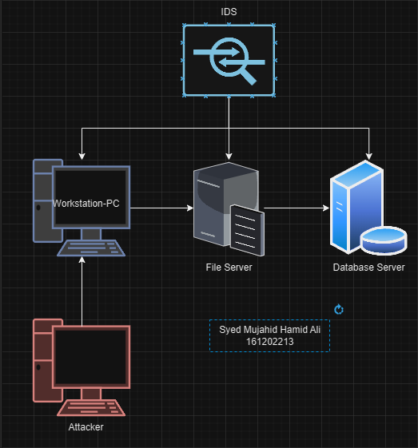
Incident Simulation Description
In this smaller scale of recreating this attack, an infrastructure was setup with five machines as shown in the network diagram above across the network 192.168.99.0/24. Three target machines were setup, namely a workstation that is connected to a file management server, on which shared folders are hosted, which were compiled and made on the database server.

Slide 5
Incident Simulation Demonstration
https://youtu.be/wws8bYEjm0c

Slide 6
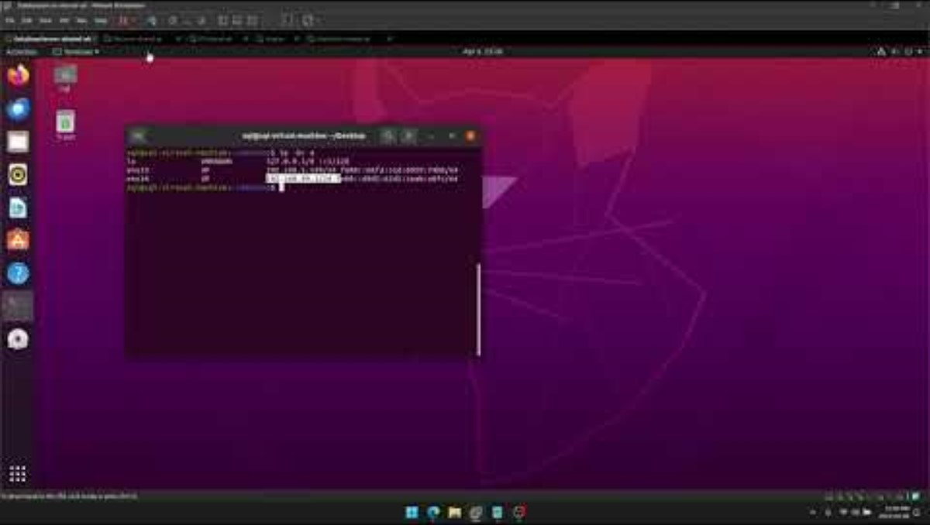

Slide 7
Incident Report Findings
A significant security breach was experienced, which classified as high-severity, involved a complex phishing attack targeting a Windows 10 Pro workstation assigned to user Barack Obama with the IP address 192.168.99.99. The breach was initiated through a deceptive email which led to the unauthorized disclosure of login credentials. The attacker subsequently gained remote access to the network. This access allowed the attacker to execute a sequence of actions, leading up to the theft of sensitive data. The attack's complexity was evident using advanced tools that not only harvested data but also manipulated file and folder permissions to conceal their activities and hinder recovery efforts.

Slide 8
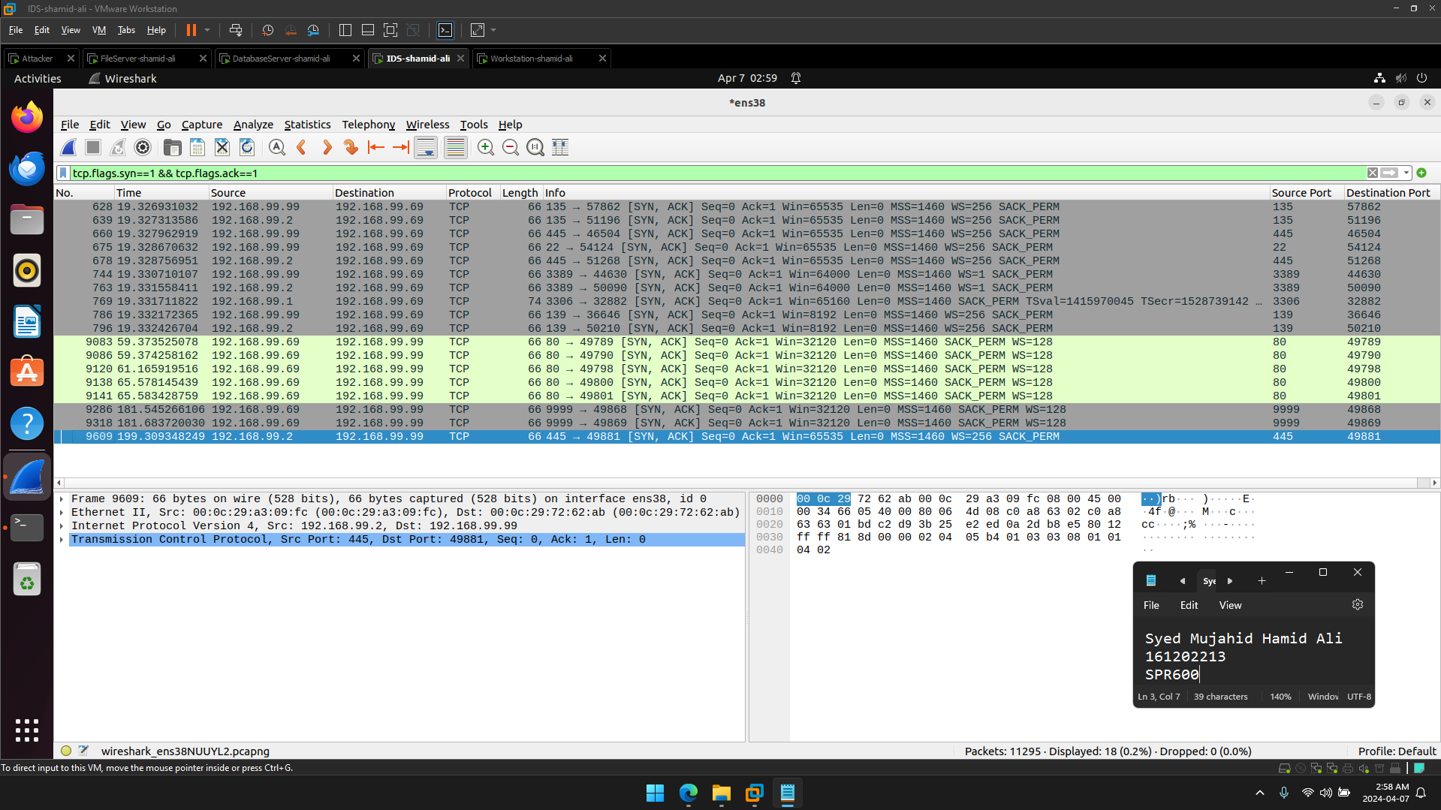

Slide 9
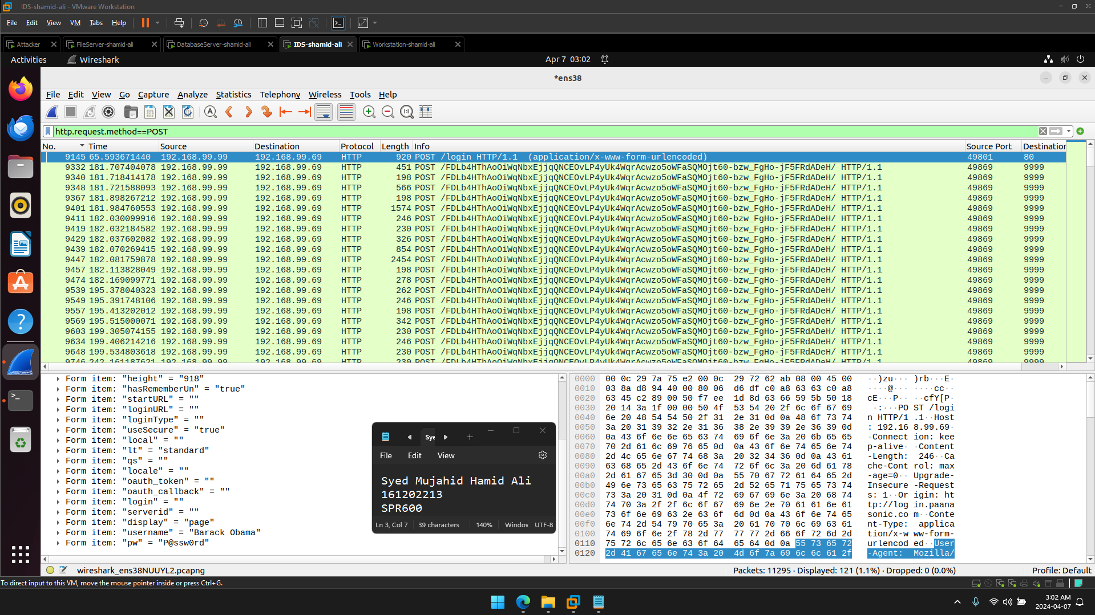

Slide 10
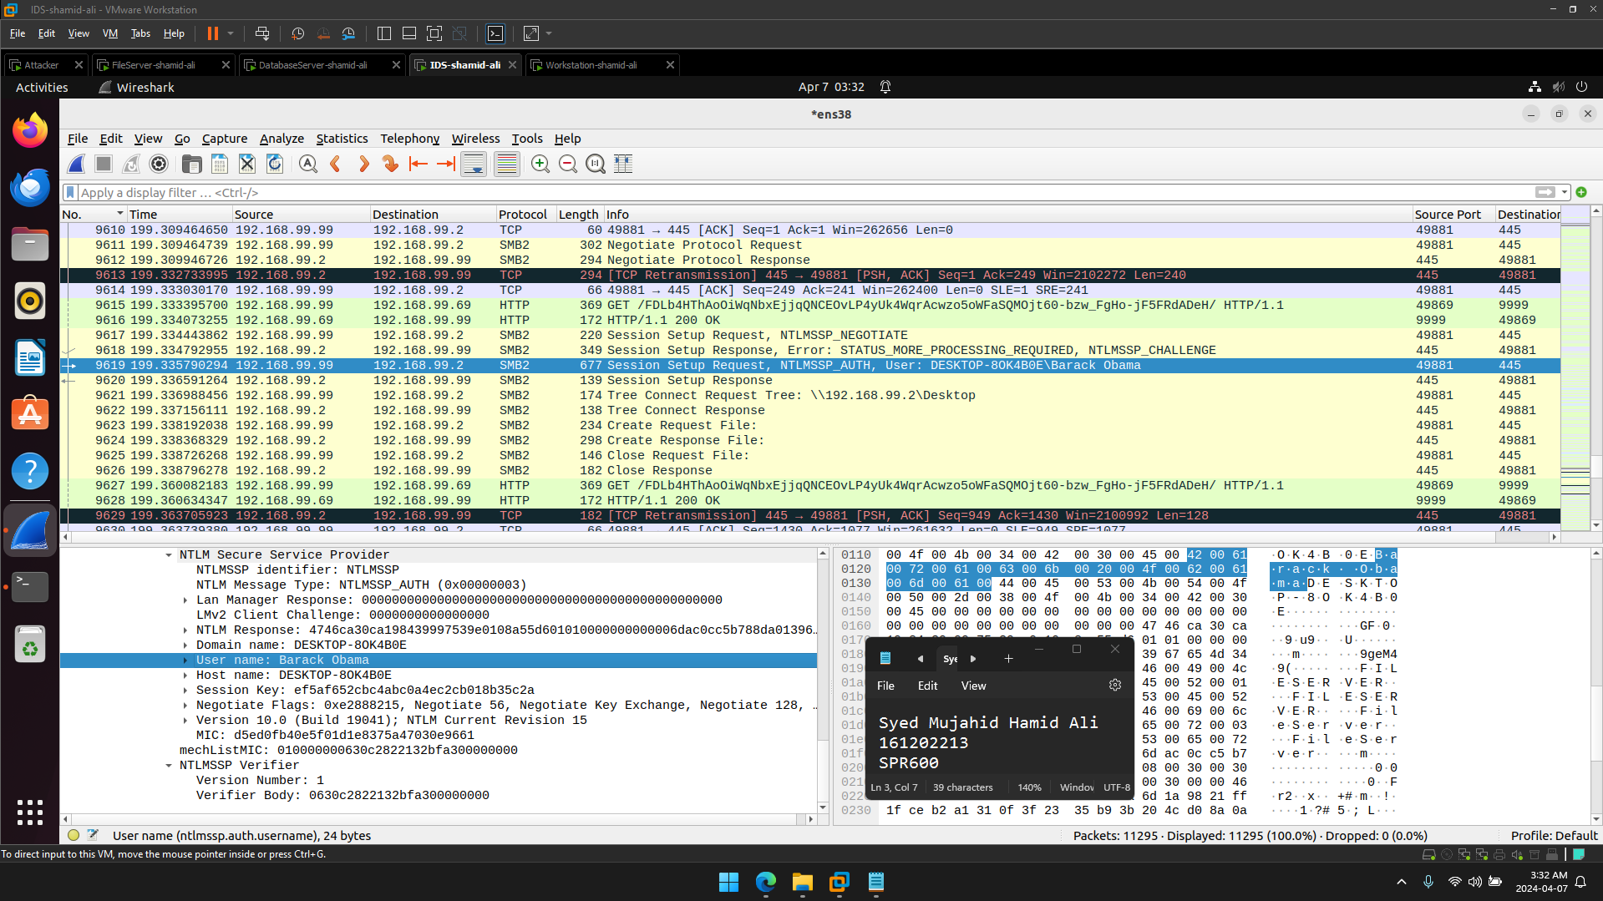

Slide 11
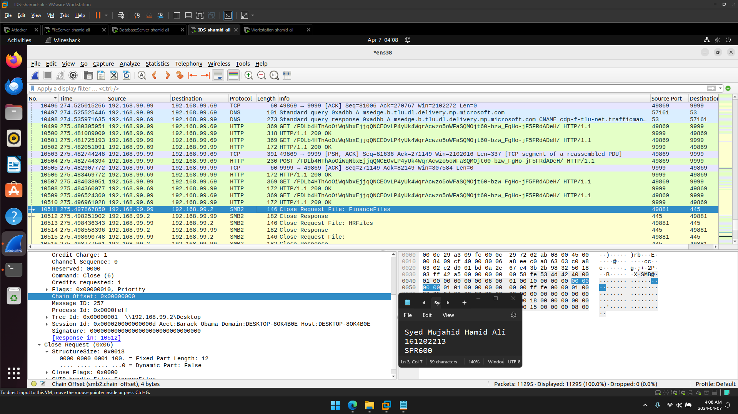

Slide 12
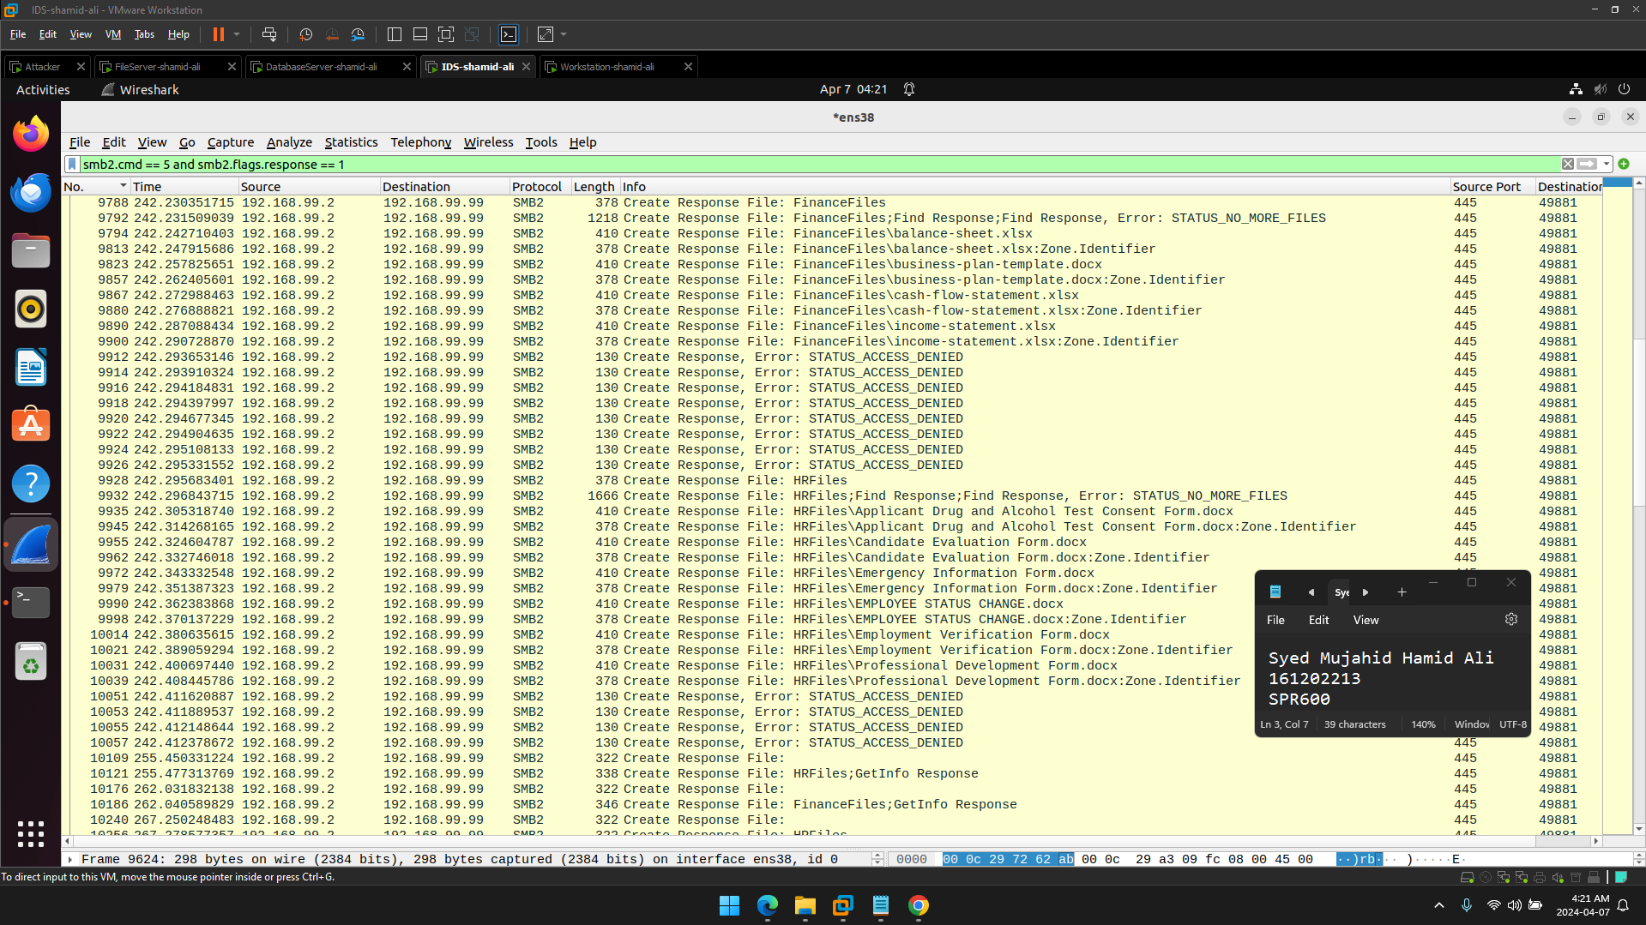

Slide 13
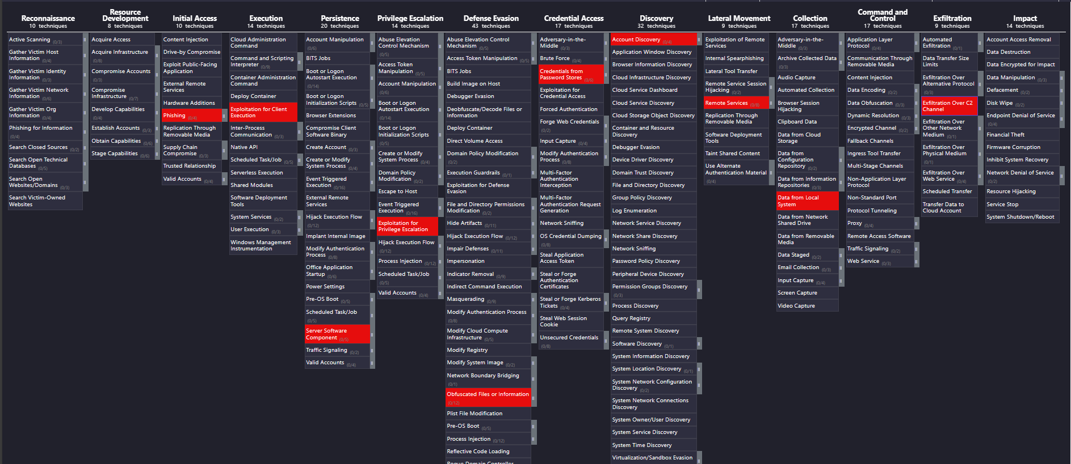

Slide 14
Thank you Syed Mujahid Hamid Ali
Q&A

